Slide 1

The Power of
Abstraction : Simplifying Complex Systems
Farjan Ahmmed
232-35-738
Course Code : SE 211 || Section : G

Slide 2
Understanding Abstraction
Definition
Abstraction is a process of hiding the implementation details and showing only
functionality to the user.
Essence
Reduces objects to their essence, exposing necessary details only.
Example
Sending an SMS involves typing and sending, without knowing the internal process.

Slide 3

Why Abstraction is Essential
1
Reduces Complexity
Improves code readability and maintainability.
2
Promotes Modularity
Allows focus on high-level logic.
3
Supports Reusability
Makes future development easier.

Slide 4
Achieving Abstraction in Java
Abstract Classes
Interfaces
Allow 0 to 100% abstraction, can contain
concrete methods.
Allow 100% abstraction, no concrete
methods.
Partial to complete abstraction
Complete abstraction
Concrete methods allowed
No concrete methods

Slide 5
Abstract Classes & Methods with Syntax
Classes
Methods
Definition
Definition
A class which is declared as abstract is known as
an abstract class.
A method which is declared as abstract and does
not have implementation is known as an abstract
method
Syntax
Syntax
access-specifier abstract class ClassName
{
// class body
}
access-specifier abstract
return-type method_name();

Slide 6
Interfaces in Java
Definition
Purpose
Key Characteristics
A blueprint with only abstract methods and static constants.
Achieves 100% abstraction with method declarations only.
Methods are abstract and public; fields are static and final.
Syntax of declaring an Interface
interface <interface_name> {
// declare constant fields
// declare methods that abstract
//by default.
}

Slide 7
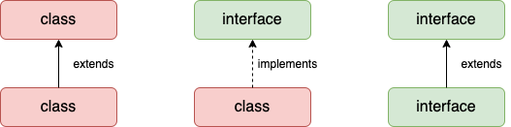
The relationship between classes and interfaces
As shown in the figure given below, a class extends another class, an interface extends another interface, but a class implements an interface

Slide 8
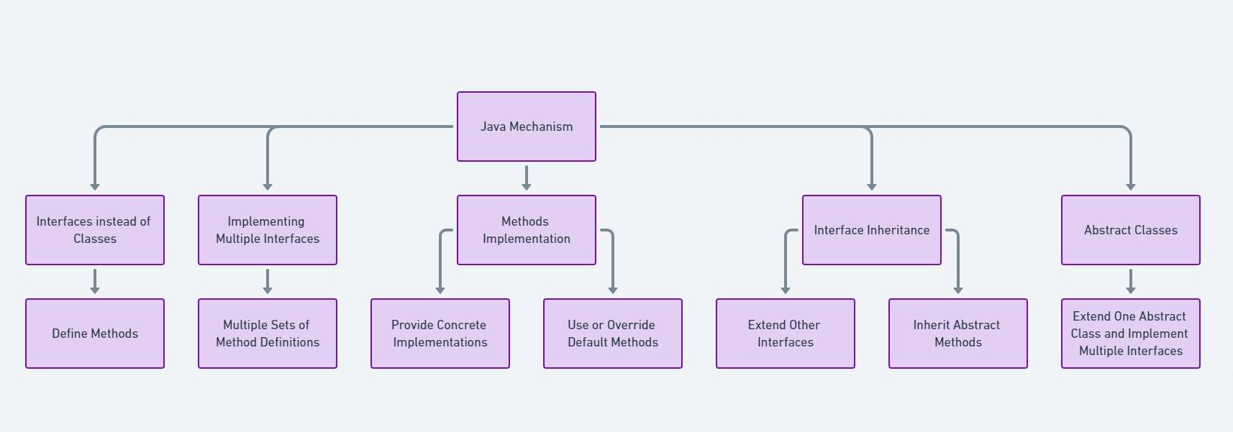
Multiple inheritance in Java by interface
If a class implements multiple interfaces, or an interface extends multiple interfaces, it is known as multiple inheritance

Slide 9
Abstract Classes vs Interfaces
Feature | Abstract Class | Interface
Multiple Inheritance | No | Yes
Method Implementation | Can include concrete methods | All methods abstract (Java 7)
Use Case | Related classes | Unrelated classes

Slide 10
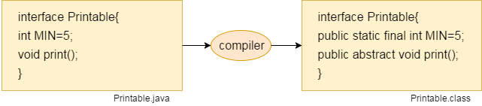
Internal addition by the compiler
The Java compiler adds public and abstract keywords before the interface method. Moreover, it adds public, static and final keywords before data members

Slide 11
Advantages & Challenges
Advantages
Challenges
Code scalability and reusability.
Requires careful planning.
Simplifies understanding of large systems.
Can lead to over-engineering.
Facilitates testing and debugging.
May introduce performance overhead.

Slide 12
Thank You

